Slide 1
Assessing Crime Rates and Drug Decriminalization
Project Group 3
Victor H. Bolima T. Arjay T. Amie Lynn S. Amber A.

Slide 2

Hypothesis
Decriminalization of drugs impact
crime rates

Slide 3
Background:
We have chosen to compare data sourced from the FBI Open Source API between Oregon, Washington State and the National average in this data set:
Oregon
Decriminalized Marijuana: 1973
Decriminalized All drugs: 2020
Washington
Decriminalized Marijuana: 2012
Decriminalized Possession of small amounts of other drugs: 2021
National
Though states are able to decide for themselves on the legalization of certain drugs, all drugs are still illegal at the Federal level

Slide 4
TIMELINE
Oregon:
Decriminalized Marijuana
Washington:
Decriminalized Marijuana
Oregon:
Decriminalized All Drugs
End of data
1973
2011
2012
2013
2014
2015
2016
2017
2018
2019
2020
2021
Start of data
National:
The First Step Act:
Reduced minimum sentences for some drug offenses
Washington:
Decriminalized possession of small amount of other drugs

Slide 5
Questions
Did the *crime rate in Oregon change after the decriminalization of drugs?
Did the *crime rate in Washington state change after the decriminalization of drugs?
How does Oregon and Washington compare to the national *crime rate?
* The crimes we are analyzing are Aggravated Assault, Drug Abuse Violations and Weapons crimes

Slide 6
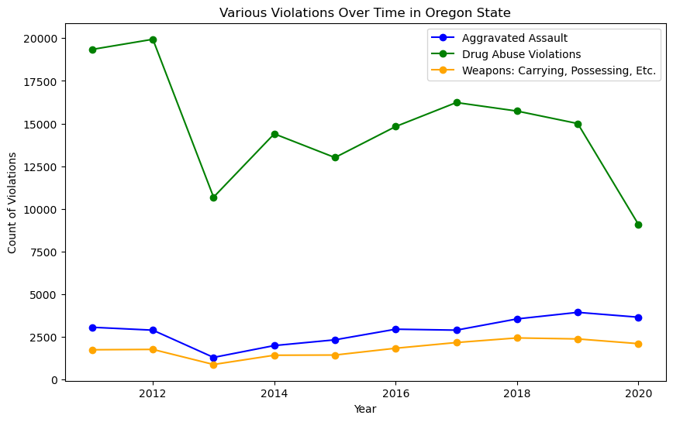
Question: Did the crime rate in Oregon change after the decriminalization of drugs?

Slide 7
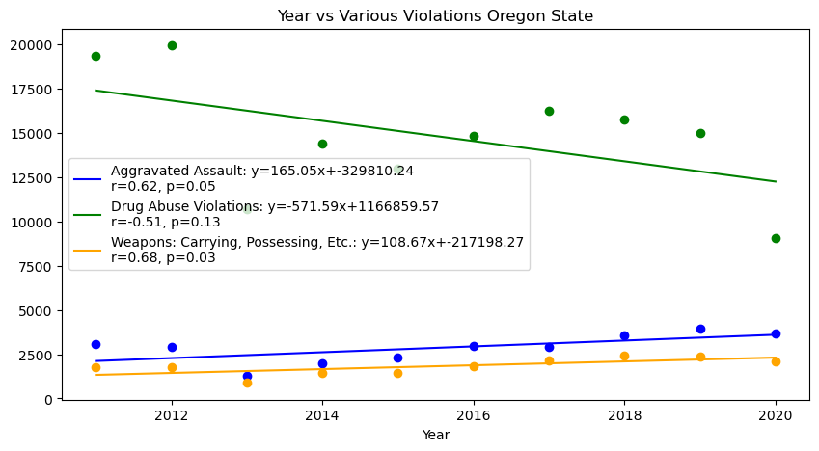
Continue…

Slide 8
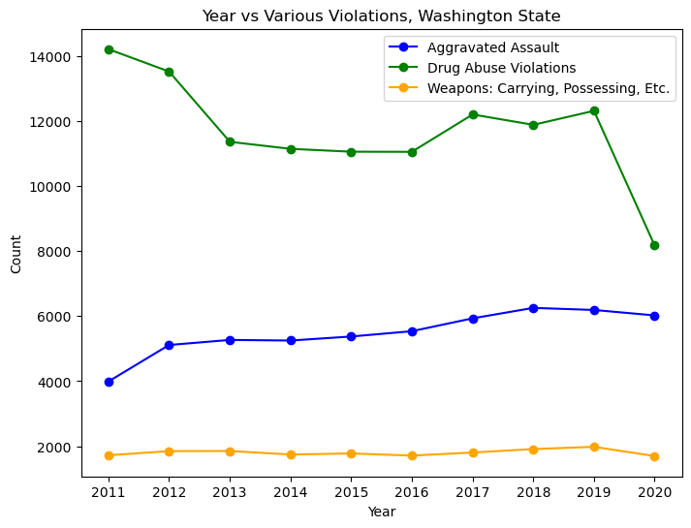
Did the crime rate in Washington state change after the decriminalization of drugs?

Slide 9
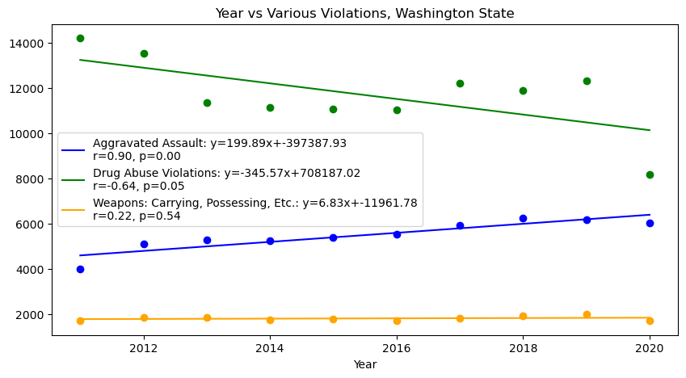
Continue…

Slide 10
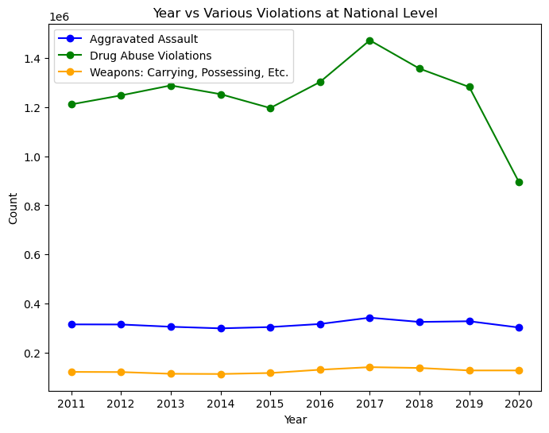
How does Oregon and Washington compare to the national crime rate?

Slide 11
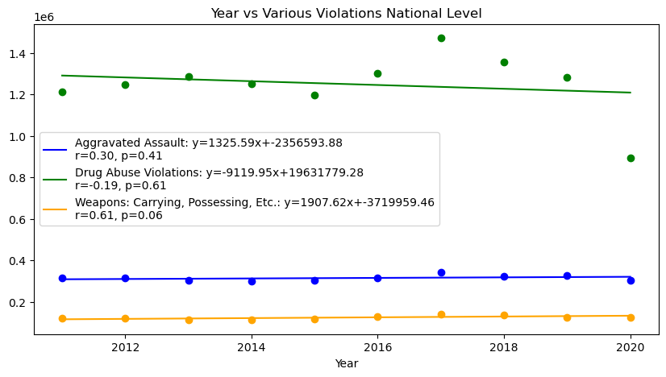
Continue…

Slide 12
Final Analysis
KEY TAKEAWAYS
More than half of the violation counts for drug abuse that dropped in the year of 2020 (10,000) in comparison to 2011-2012 (20,000), 2020 happens to be the same year that Oregon decriminalized all drugs
Not much of a significant difference for the numbers when it comes to aggravated assault, weapon carrying, and other crime violations as the numbers range from 1,000 to 3,000 over the decade. The lowest the numbers ever got for these crime violations happened in 2013 which was way before the other drugs have been decriminalized for Oregon
Washington state legalized the recreational use of marijuana in 2012. Which is the same year that shows where the drug abuse violation count goes from 14,000 which was just a year before, down to a little below 12,000. These numbers progressively went down to 8,000 in 2020.
In the same year that Washington legalized the recreational use of marijuana, the aggravated assault violation count rises over 1,000 which does increase a little over the decade but doesn’t go over 6,000. As for weapon carrying, and the other crime violation counts they were kept at 2,000 or less for the decade in the state of Washington
The national crime rates is quite similar when we compare it to both Oregon and Washington state, given the fact that the count for drug abuse violations were high during the year of 2011 but significantly dropping the count down to half of that in the year 2020
As for the violation counts for the aggravated assault, weapon carrying, and other crime violations, it was kept at a steady rate in comparison to Oregon and Washington which both states numbers were fluctuating

Slide 13
Conclusion
Given that 81% of our p-Values are greater than .05, we are comfortable stating that decriminalization of drugs do not have an impact on the crime rate.
p-Values
 | Aggravated Assault | Drug Abuse Violation | Weapons: Carrying, Etc.
Oregon | .05 | .13 | .03
Washington | .00 | .05 | .54
National | .41 | .61 | .06

Slide 14

THANKS!
Any questions?

